Slide 1
Object Oriented Software Development (C++) OOP345
Madiha Kazmi

Slide 2
Assessment Summary
Workshops | 25% | Best 8 (@3.125% each) out of min. 9
Final Project | 15%
Quizzes | 15% | Best 8 (@1.875% each) out of min. 10
Test #1 | 15%
Test #2 | 30%

Slide 3
Week 11
Multi-Threading
01
Thread Classes
02

Slide 4
Objective- Multi-Threading
Introduce concurrency and multi-threading
Define the common terms associated with multi-threading
This chapter introduces the topic of multi-threading.
It describes the difference between threads and processes, the importance of tasks and communications in multi-threaded programming and some of the related terminology.
This chapter concludes by listing some of the STL algorithms that accept execution policy arguments.

Slide 5
Multi-Threading
"Although threads seem to be a small step from sequential computation, in fact, they represent a huge step. They discard the most essential and appealing properties of sequential computation: understandability, predictability, and determinism. Threads, as a model of computation, are wildly non-deterministic, and the job of the programmer becomes one of pruning that nondeterminism." Lee (2006)

Slide 6
Multi-Threading
At the beginning of the millennium, the industry-wide introduction of multi-core CPUs to the consumer market promoted the need for multi-threading support in all object-oriented languages.
Multi-core CPUs can execute different strands of code concurrently and thereby enhance program performance.
A multi-threaded programming solution improves the elapsed time to complete execution by distributing independent tasks across separate hardware threads.
The C++11 standard introduced direct multi-threading facilities. Its standard library includes a comprehensive set of libraries that support simple as well as complex multi-threading.
Moreover, C++17 enhanced the algorithms of the Standard Template Library to accommodate execution policies that allow both sequential and parallel processing.

Slide 7
Performance​
A program's performance can be described in terms of two aspects:
Tasks are computationally intensive and consume processor time.
Communications involve the transfer of information between processors and memory and can render processors delay processor time.
A task represents a group of instructions.
It can refer to an entire program or a relatively small part of a much larger program.
Communications occur across communication channels between a processor and main memory or a processor and a resource, such as a file stream, input stream or output stream.
The time to complete a communication is referred to as its latency.
The latency of a communication between a processor and a resource is at least one order of magnitude greater than that between the processor and main memory.
Accessing a resource can leave the processor idle for a considerable period of time.
A processor waiting for a communication to complete is available to execute another task or another program.

Slide 8
multi-tasking
Operating systems are designed to switch from one task or program to another. The system of switching from one task to another is called multi-tasking.

Slide 9
Role of Problem Size​
A program's performance becomes an issue once the program is used to solve problems of a certain size. The amounts of time and space (i.e., memory) that it requires to execute increase with problem size. Problems of large size can consume enough time or space to make the program's performance a critical programming issue.
The time and space that a program requires for its completion is described in terms of its complexity. The two distinct measures are time complexity and space complexity.
Time complexity refers to the rate at which elapsed time grows with problem size.
Space complexity refers to the rate at which memory requirements grow with problem size. For instance, the initialization of 1,000 elements to a value takes 1,000 units of time (linear complexity), while sorting the same 1,000 elements can take about 1,000 * 1,000 = 1,000,000 units of time (quadratic complexity). That is, while the setting of individual elements in an array might need not require our attention, the sorting parts of the same program may require attention if the problem size is large enough.

Slide 10
Multi-tasking
Multi-tasking differs from multi-threading. Their difference can be described in terms of the distinction between a process and a thread.

Slide 11
Process​
A process is an instance of a program executing on the host platform. The compiled program takes the form of a file on secondary storage.
When the user instructs the operating system to load the executable program from this file into main memory, the system creates a process.
When the system transfers control to the process' entry point, execution starts.
At any instant during its execution the process contains all of the information related to its current activity.
When the process finishes executing, it returns control to the operating system and leaves the main memory it used ready for a new process.

Slide 12
Process​
If a process requests a resource, the system's multi-tasking scheduler blocks the process and may start or restart another process. Once the requested resource is available, the scheduler places the blocked process in a wait state ready to restart. When the scheduler blocks another executing process, it can restart the waiting process.
This switch from one process to another is called a context switch. A process' context refers to the contents of the CPU's registers and program counters at the instant of blocking. A context switch suspends an executing process and stores its context in memory. The scheduler then retrieves the context of a waiting process from memory, restores it in the CPU's registers and program counters and restarts the reloaded process.
A context switch on a process is computationally intensive. The processor time required may be in the order of several thousand clock cycles.

Slide 13
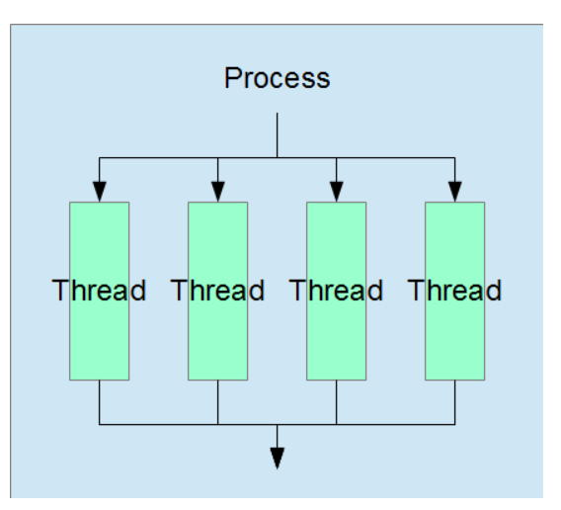
Thread​
A thread is a sequence of program instructions that represents an independent flow of control within a process. Threads are light-weight versions of parts of processes. A thread can run concurrently with other threads and share the same address space with other threads. The task that each thread executes is part of the thread's host process.
A thread may be a software thread or a hardware thread. A software thread is a virtual thread associated with a task within a process. The task may be the same or different from the task associated with another thread. A hardware thread is a mini-process that executes a software thread (that is, the task associated with the software thread). The operating system's scheduler maps software threads to hardware threads.

Slide 14
Thread​
Depending on the hardware available, the operating system can schedule several threads for concurrent execution. This is called multi-threading.
While the operating system completely controls the multi-tasking of its loaded processes, we can include within each process instructions that control multi-threading of that process' various tasks.
A context switch on a thread is similar to a context switch on a process. As a processor waits to complete a software thread's communication, the scheduler blocks the thread and may switch to another thread. Importantly, a context switch on a thread is much less computationally intensive than a context switch on a process.
The processor time required may be in the order of several hundred clock cycles. In other words, a thread is the lighter unit of system scheduling, while a process is the heavier.

Slide 15
Terminology​
A process starts executing on a single thread. When it encounters an instruction that divides the execution path into concurrent tasks, we say that the process launches a concurrent task or spawns a child thread. When the child thread reunites with its parent, we say that the two join or the child and parent threads synchronize. The join point in the execution path is the synchronization point. If either task is still executing when the one thread reaches this point, that thread waits until the other has completed its task.

Slide 16
Shared Memory
​Multi-threaded programs share memory. Their complexity arises from the possibility of a thread accessing variables that it shares with other threads. Users expect the results of a program to be reproducible no matter how many times they are run. With multi-threaded programs, users expect the same results for the same set of inputs. That is, they expect a determinate solution. Since the order in which threads execute their instructions is indeterminate, multi-threaded programming demands attention and care whenever concurrently executing threads access a shared variable.

Slide 17
Shared State​
A shared state is a state shared by two threads for the purpose of communicating a value from one thread to the other. C++11 uses this technique in its thread libraries.

Slide 18
Mutexes, Locks, and Atomics​
Mutex stands for mutual exclusion. It is a technique that excludes access by other threads to a memory location while a particular thread updates the value at that location. Mutexes are implemented using locks. The thread that is changing the value owns a lock on the memory locations and must release it before any other thread can acquire that lock.
The C++11 thread libraries include a library for implementing mutexes and locks. This technique, which is used in many multi-threaded programming solutions is beyond the scope of these notes.

Slide 19
Atomics​
The C++11 libraries also include an atomics library for implementing lock-free execution of instruction. Atomics treat an instruction as indivisible. This technique is used in many multi-threaded programming solutions and is also beyond the scope of these notes.

Slide 20
Deadlock​
A deadlock occurs when two or more threads are waiting for one another to complete execution and therefore are blocked forever.

Slide 21
Policy-Based Execution​-Execution Policies​
C++17 introduced execution policies to specify the method of computation on multi-threaded and vector hardware. The C++17 version of the STL algorithms accommodates these policies.
Policy Types​: C++17 identifies three policy types:
std::execution::sequenced_policy - execution may not be parallelized: the element access functions are indeterminately sequenced in the calling thread
std::execution::parallel_policy - execution may be parallelized: the element access functions may execute in either the invoking thread or in a thread implicitly created by the library to support parallel algorithm execution
std::execution::parallel_unsequenced_policy - execution may be parallelized, vectorized or migrated across threads: the element access functions may execute in unordered fashion in unspecified threads

Slide 22
Example
Multithreading | Object Oriented Software Development (C++) (sdds.ca)

Slide 23
Thread Class
​The thread class defines an object that represents a single thread of execution in a process. The thread class template is defined in the header file <thread>.
A thread object is either joinable or not-joinable. A joinable object represents an actual thread of execution with a unique id. A non-joinable object represents a potential thread of execution (the object is not associated yet with a hardware thread, or the thread has been already joined). Operations on a thread object can change its joinable/non-joinable state.

Slide 24
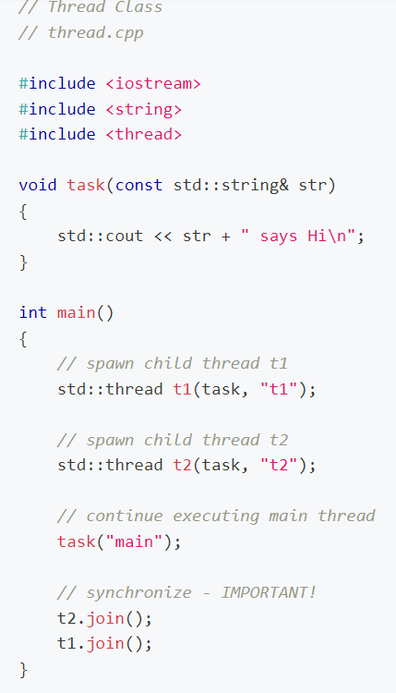
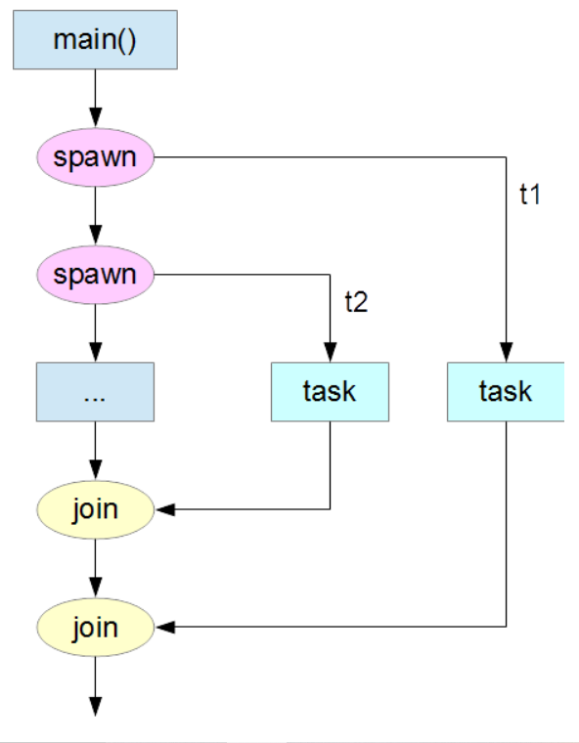
Example​
The following program executes three tasks concurrently. It spawns two child threads from its main thread, executes all three tasks and waits in its main thread for the spawned threads to finish.

Slide 25
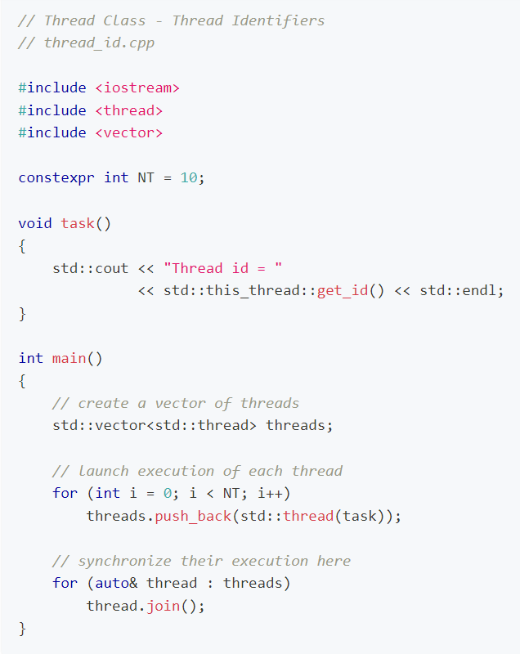
Thread Identifier
​The thread identifier of a joinable thread object is accessible from within the function executing the thread's task. std::this_thread::get_id() returns this identifier.
The following program launches 10 thread objects and displays their identifiers on standard output. The program creates each object through the constructor template with the address of a function as its sole argument:

Slide 26
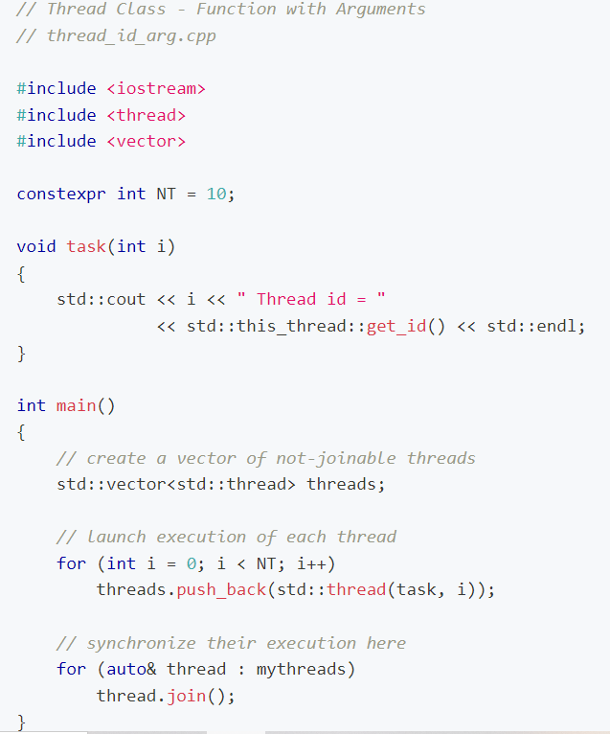

Slide 27
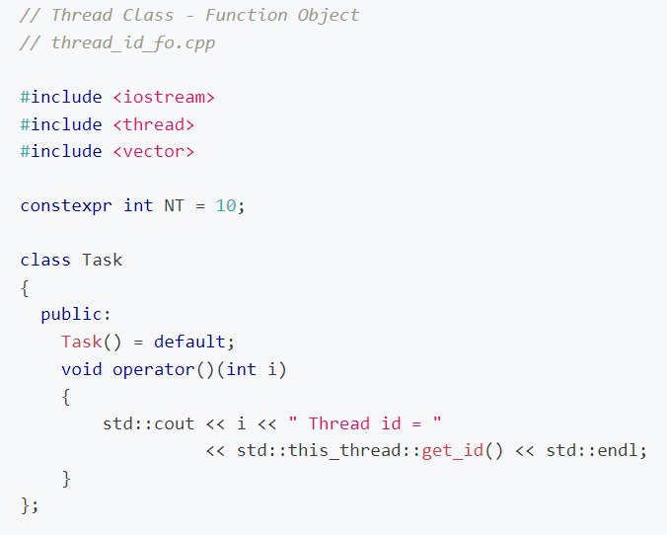
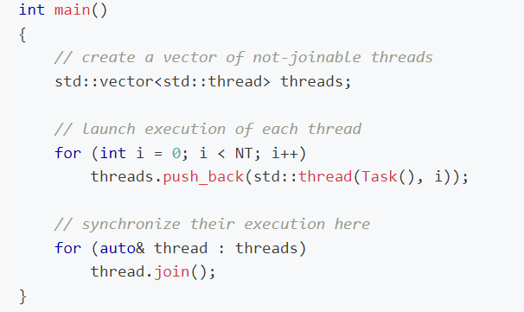
Function Object​
The function object version of the above example is as follows:

Slide 28
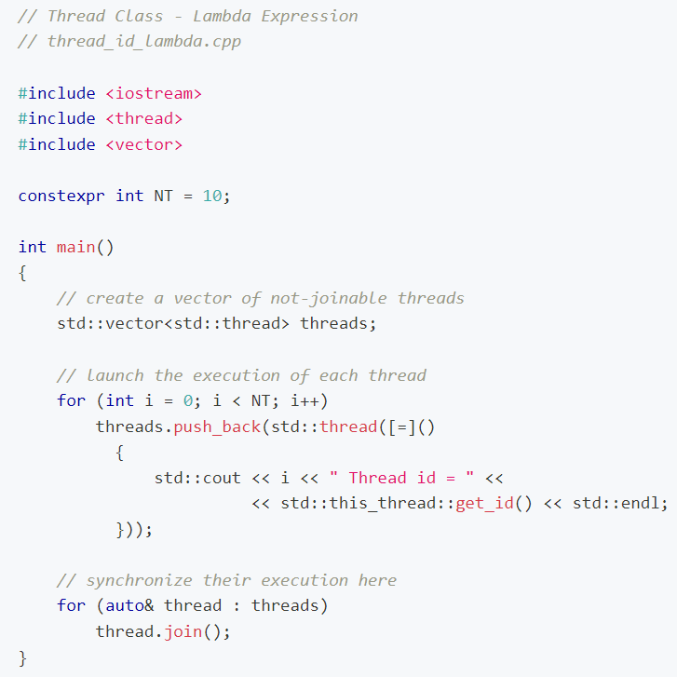
Lambda Expression​
The lambda expression version of the above example is more compact and accesses the index i by value as a non-local variable:

Slide 29
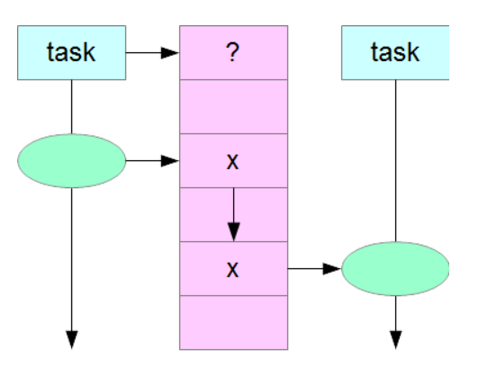
future Library​
The future library of the thread support category facilitates efficient transfer of values between tasks through shared states. The class and function templates that support communications across a shared state are defined in the header file <future>.
A future object retrieves a value that a provider has stored in a shared state. Each provider-future pair establishes a synchronization point for two tasks that are executing concurrently. The provider creates an empty shared state on initialization. Once the provider has supplied a value to that shared state, that state is ready for access by the future object associated with that provider. A shared state can survive the lifetime of its provider.

Slide 30
Futures
Instantiation of the templated std::future class creates a future object. A future object is either valid or not-valid. A valid object is associated with a shared state and can retrieve the value of that shared state once it is ready. Until it is ready, any retrieval request necessarily waits.
Member Functions​
The member functions of the templated future class include:
future() noexcept - creates a future object not associated with a shared state
future(future&& f) noexcept - moves the shared state from future f to the current object
~future() - disassociates the shared state from the current object and destroys the state if not associated with any other object
future& operator=(future&& f) noexcept - acquires the shared state of future f
T get() - returns the value stored in the current object's shared state, if ready; waits, if not ready
bool valid() const noexcept - returns true if the current object is associated with a shared state
void wait() const - waits for the current object's shared state to be ready
This class' copy-constructor and the copy-assignment special member functions are deleted.

Slide 31
Providers​
A provider object complements a future object. One of the following templates can instantiate a provider object:
std::promise class template
std::packaged_task class template
std::async() function template

Slide 32
promise Objects
​A promise object creates or acquires a shared state in which it can store a value.
The templated promise class defines a simple set_value() counterpart to the get() member function of the templated future class. The member functions of the templated promise class include:
promise() - a promise object with a new empty shared state
promise(promise&& p) noexcept - moves the shared state from promise p to the newly created current object
~promise() - abandons the shared state and destroys the promise
promise& operator=(promise&& p) noexcept - moves the shared state from promise p to the current object
future<T> get_future() - returns the future object associated with the current object's shared state
void set_value(const T&) - stores a value in the current object's shared state, making it ready for retrieval
void swap(promise& p) - swaps the shared state of the current object with the shared state of object p
This template's copy-constructor and the copy-assignment operations are deleted.

Slide 33
packaged_task Object
A packaged_task object consists of two components: a stored task and a shared state.
The templated packaged_task class defines a simple wrapper for passing the result of a task to a future object; that is, for launching a thread that executes a task and capturing the return value, which a future can subsequently retrieve. The member functions of the templated packaged_task class include:
packaged_task() - a packaged_task object with no shared state and no task
packaged_task(packaged_task&& p) noexcept - moves the shared state and stored task from packaged_task p to the newly created current object
~packaged_task() - abandons the shared state and destroys the packaged_task
packaged_task& operator=(packaged_task&& p) noexcept - acquires the shared state and stored task from packaged_task p
bool valid() const noexcept - returns true if the current object is associated with a shared state and a stored task
future<T> get_future() - returns the future object associated with the current object's shared state
void operator()(Args...) - forwards the function arguments of type Args to the stored task and initiates its execution
void swap(packaged_task& p) - swaps the shared state of the current object with that of object p
This template's copy-constructor and copy-assignment operations are deleted.

Slide 34
async() function​
The templated async() function provides an extremely simple pair that spawns a thread to execute a task and creates a future for retrieving the return value from that task.
An async() function
accepts the address of the function that defines the task
launches the task
reverts control to its caller
returns a future object that can retrieve the value returned on the task's completion
The executing task stores the return value temporarily in a shared state. The future object can retrieve the value from this shared state.
The template for an async() function has the form
template<class Fn, class... Args>
future<typename result_of<f(Args...)>::type> async(Fn&& fn, Args&&... args);
fn is a pointer to a function or any kind of move-constructable function object of type Fn and args denotes arguments of type Args to the function, where type is also move-constructable.

Slide 35
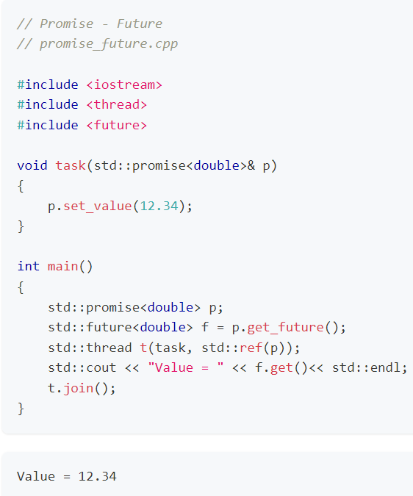
Examples Promise - Future
Fulfilling a promise on a child thread and retrieving the promised value on the main thread involves passing the promise object by reference to the thread. In the following program task() on thread t fulfills the promise by setting a value. The main thread retrieves that value.
Note that any return value from the function executed by a child thread can be captured by an std::promise object. The return value from the function is otherwise ignored.

Slide 36
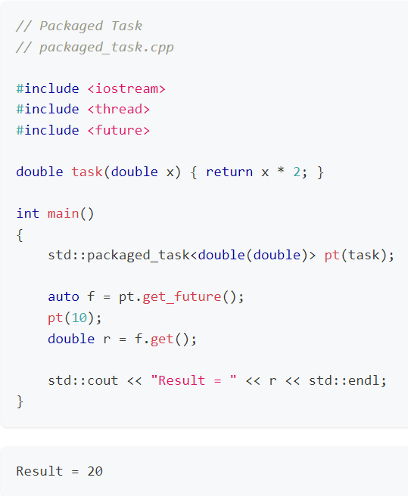
Packaged Task​
The following program packages a task and a shared state. The get_future() member function retrieves the future object that will hold the return value generated by execution of the task. Calling the packaged_task executes the task, while calling the get() member function on the future object retrieves the return value, which the main function can then display:

Slide 37
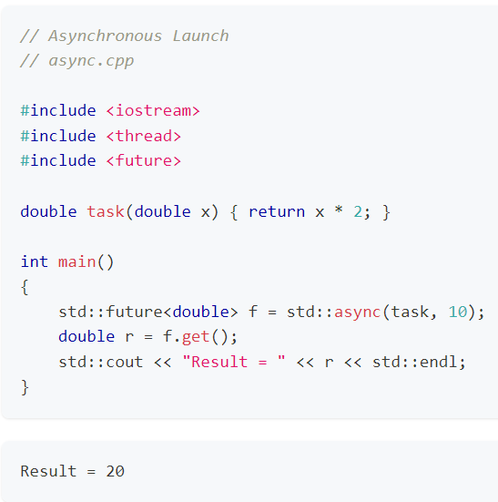
async()
The following program launches task() asynchronously and returns the future object associated with the shared state. The get() member function on the future object retrieves the value of the shared state, which the main function can then display:

Slide 38
summary
Multitasking
Multithreading
Processes
Thread
Terminologies

Slide 39
exercise
Read Wikipedia on Threads

